Slide 1
Common Core State Standards Alignment

Slide 2

What is Common Core State Standards (CCSS)

Slide 3
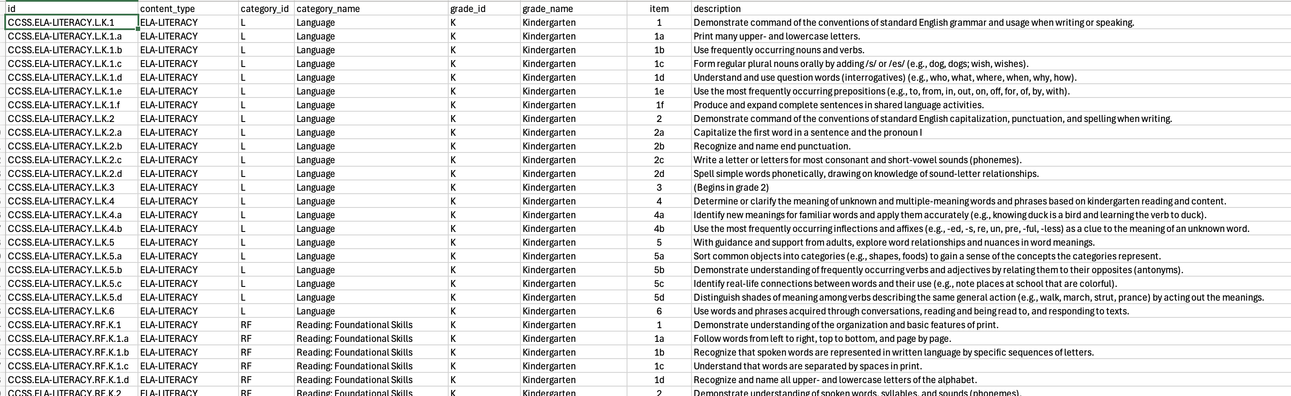
CCSS for ELA

Slide 4
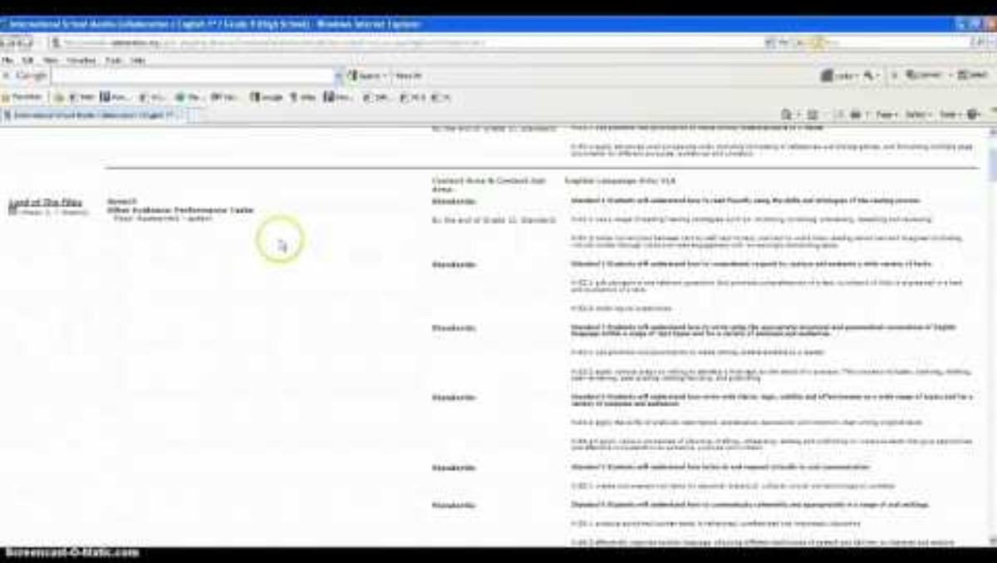
CCSS Alignment

Slide 5
Data Set
CSV file with about 1,500 rows
Important Columns
CCSS id: e.g., CCSS.ELA-LITERACY.L.K.1
Description: e.g., Demonstrate command of the conventions of standard English grammar and usage when writing or speaking.

Slide 6
Task
Using NLP and ML to build a model
Input: any texts and a number N
Output: the closest N number of CCSS ids to the input texts ranked by the closeness

Slide 7
Questions?

